Slide 1
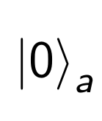
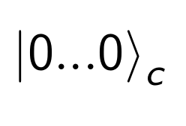
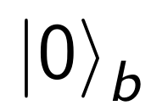
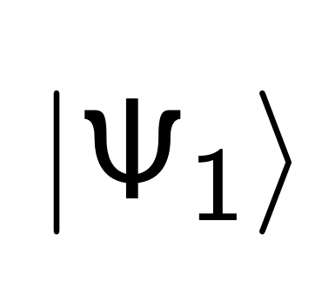
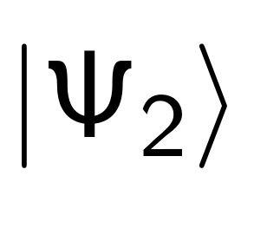
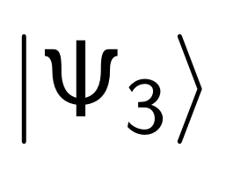
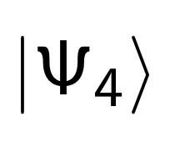
Input
QPE
Rotation
IQPE
Measurement
a-register
R
c-register
H
FT†
FT
H
b-register
U
U†

Slide 2
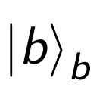
Input
QPE
Rotation
IQPE
Measurement
a-register
R
c-register
H
FT†
FT
H
b-register
U
U†

Slide 3
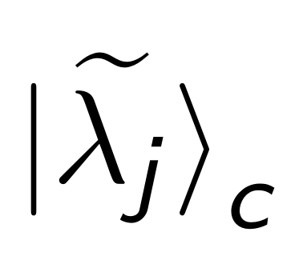
Input
QPE
Rotation
IQPE
Measurement
a-register
R
c-register
H
FT†
FT
H
b-register
U
U†

Slide 4
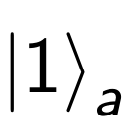
Input
QPE
Rotation
IQPE
Measurement
a-register
R
c-register
H
FT†
FT
H
b-register
U
U†

Slide 5
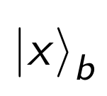
Input
QPE
Rotation
IQPE
Measurement
a-register
R
c-register
H
FT†
FT
H
b-register
U
U†

Slide 6
Input
QPE
Rotation
IQPE
Measurement
a-register
R
c-register
H
FT†
FT
H
b-register
U
U†

Slide 7
Input
QPE
Rotation
IQPE
Measurement
a-register
R
c-register
H
FT†
FT
H
b-register
U
U†

Slide 9
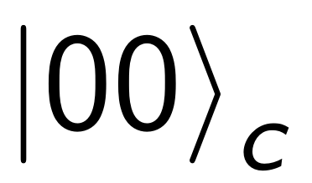
Input
QPE
Rotation
IQPE
Measurement
a-register
c₀-register
c₁-register
b-register

Slide 10
Input
QPE
Rotation
IQPE
Measurement
a-register
c₀-register
c₁-register
b-register

Slide 11
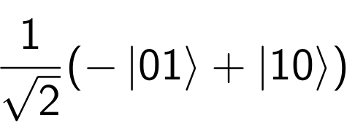
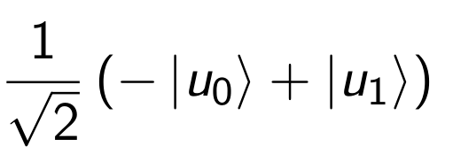
Input
QPE
Rotation
IQPE
Measurement
a-register
c₀-register
c₁-register
b-register

Slide 12
Input
QPE
Rotation
IQPE
Measurement
a-register
c₀-register
c₁-register
b-register

Slide 13
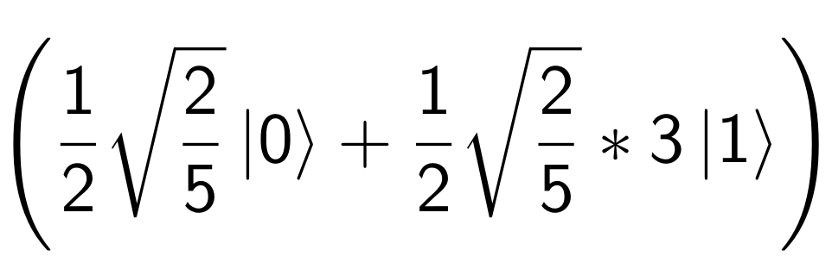
Input
QPE
Rotation
IQPE
Measurement
a-register
c₀-register
c₁-register
b-register

Slide 14
Input
QPE
Rotation
IQPE
Measurement
a-register
c₀-register
c₁-register
b-register

